Slide 1

IST 597: Foundations of Data Privacy Introduction to Differential Privacy
February 28, 2022
Partial slide credit: Anna Squicciarini (PSU), Kobbi Nissem (Georgetown)

Slide 2
Logistics,
Groups, etc.
https://docs.google.com/document/d/1TYMT4HfcAcw4HR930UufaWkSO7xEWlQtc-32ma00ZVY/edit
Homework 3 will be released March 14 and due March 28.

Slide 3
Class Outline
Intro to DP & hands-on
Break & post to discussion (20 minutes)
Presentation – Privacy in IoT (30 minutes)
Sensitivity & hands-on

Slide 4
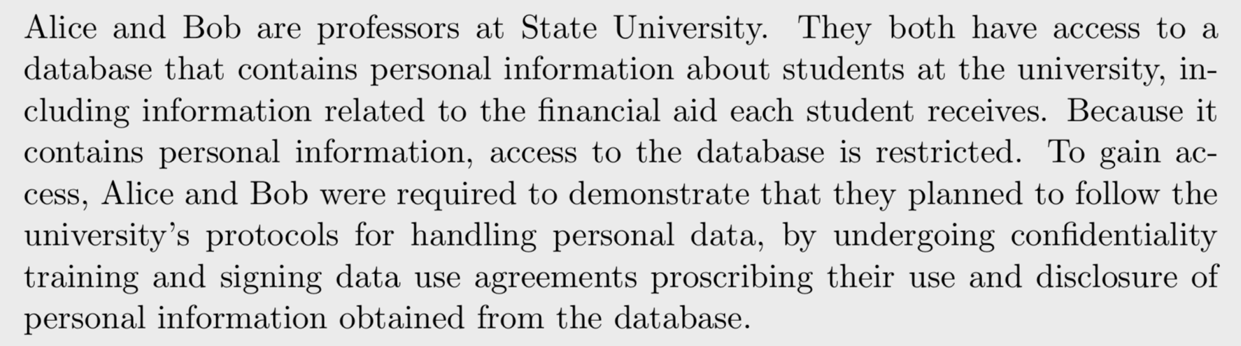
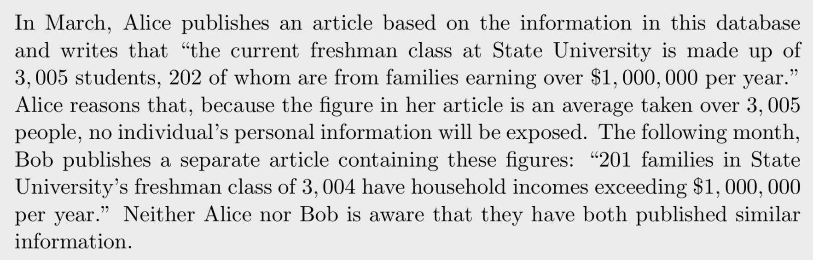
What could go wrong?
Wood et al, 2017

Slide 5
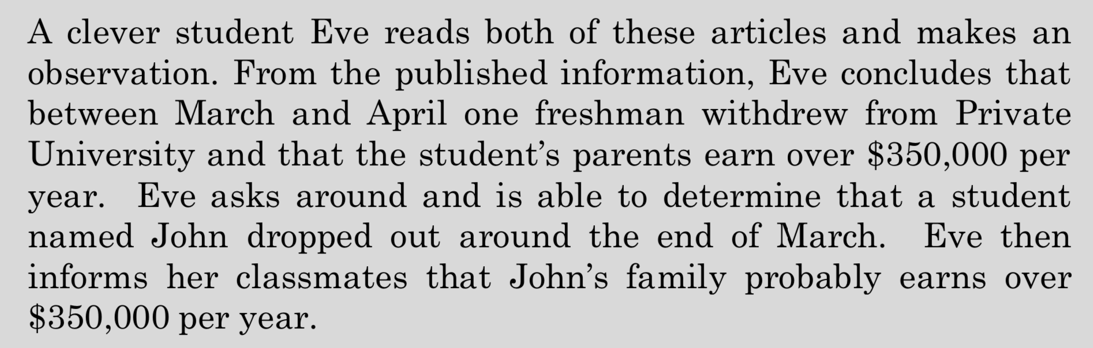
What kind of attack is this?
What could Alice and Bob have done differently to prevent this? (Anything you learned in the previous three weeks?)

Slide 6
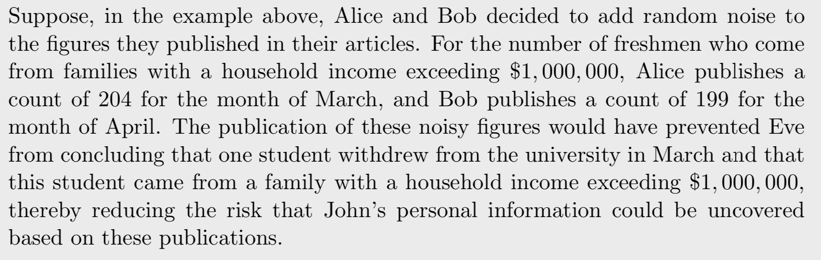

Slide 7
Add noise
***There is some nuance to this. How much noise? What kind of noise? Where/how/when do I add it?
I.e., The outcome is not exact but an approximation, and if performed twice, may return different results.

Slide 8
Introduction to differential privacy
The model

Slide 9
30,000 foot view
Like k-Anonymity, differential privacy is a formal notion of privacy (i.e., it's possible to prove that a data release has the property).
Unlike k-Anonymity, differential privacy is a property of algorithms, and not a property of data.

Slide 10
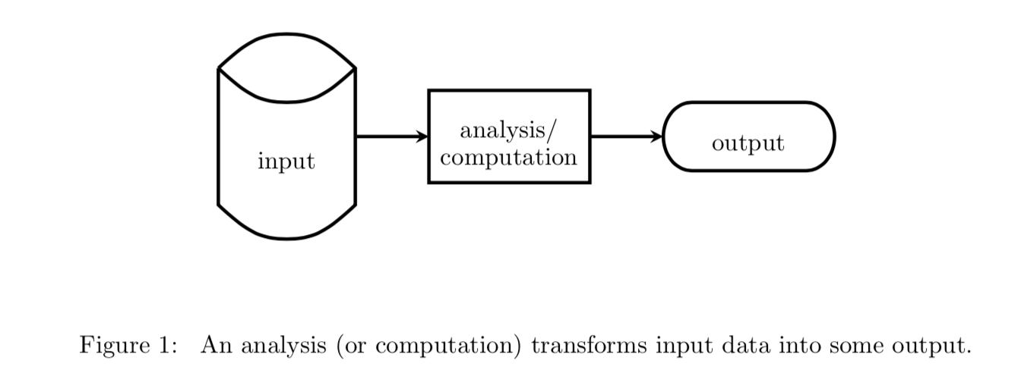
Consider an analysis on data containing personal information about individuals.
The analysis may be as simple as determining the average age of the individuals in the data, or it may be more complex and utilize sophisticated modeling and inference techniques.
In any case, the analysis involves performing some analysis/computation on (transformation of) input data and outputting the result.
(Algorithms)
An analysis protects the privacy of individuals in the data if its output does not reveal any information about any specific individual.
Wood et al., 2017

Slide 11
John | 190 Sandy Ridge Rd. | $110,500/yr | HIV negative….
If an analysis on the data from this study is designed to be differentially private, then John is guaranteed that even though his information is used in the analysis, the outcome of the analysis will not disclose anything that is specific to him.

Slide 12
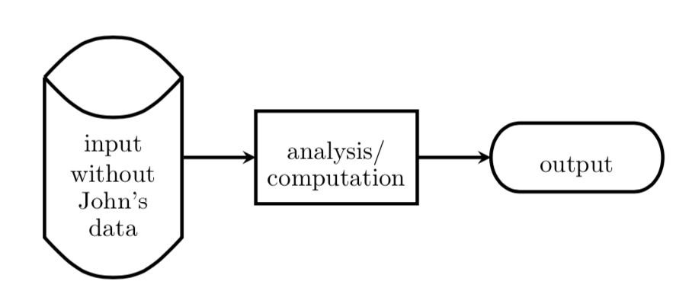
The “opt-out” scenario
Consider John’s opt-out scenario -- an analysis is performed over the dataset as usual, with one exception: information about John is omitted.
Because John’s information is omitted from the analysis, his privacy is protected in the sense that the outcome of the analysis does not depend on his specific information (i.e., the analysis would not change at all if John’s personal details were completely different).

Slide 13
John’s opt-out scenario
John’s real-world scenario
Differential privacy aims to protect John’s privacy in the real-world scenario in a way that mimics the privacy protection he is afforded in his opt-out scenario.
I.e., what can be learned about John from a differentially private computation is (essentially) limited to what could be learned about him from everyone else’s data without his own data being included in the computation.
*Crucially, this same guarantee is made to every other individual contributing their information to the analysis!
*
**How can you guarantee (what’s the only way) that an output of analysis on the real-world dataset is that same as the output of that same analysis on the data without John’s record?

Slide 14
Toward a technical formulation

Slide 15
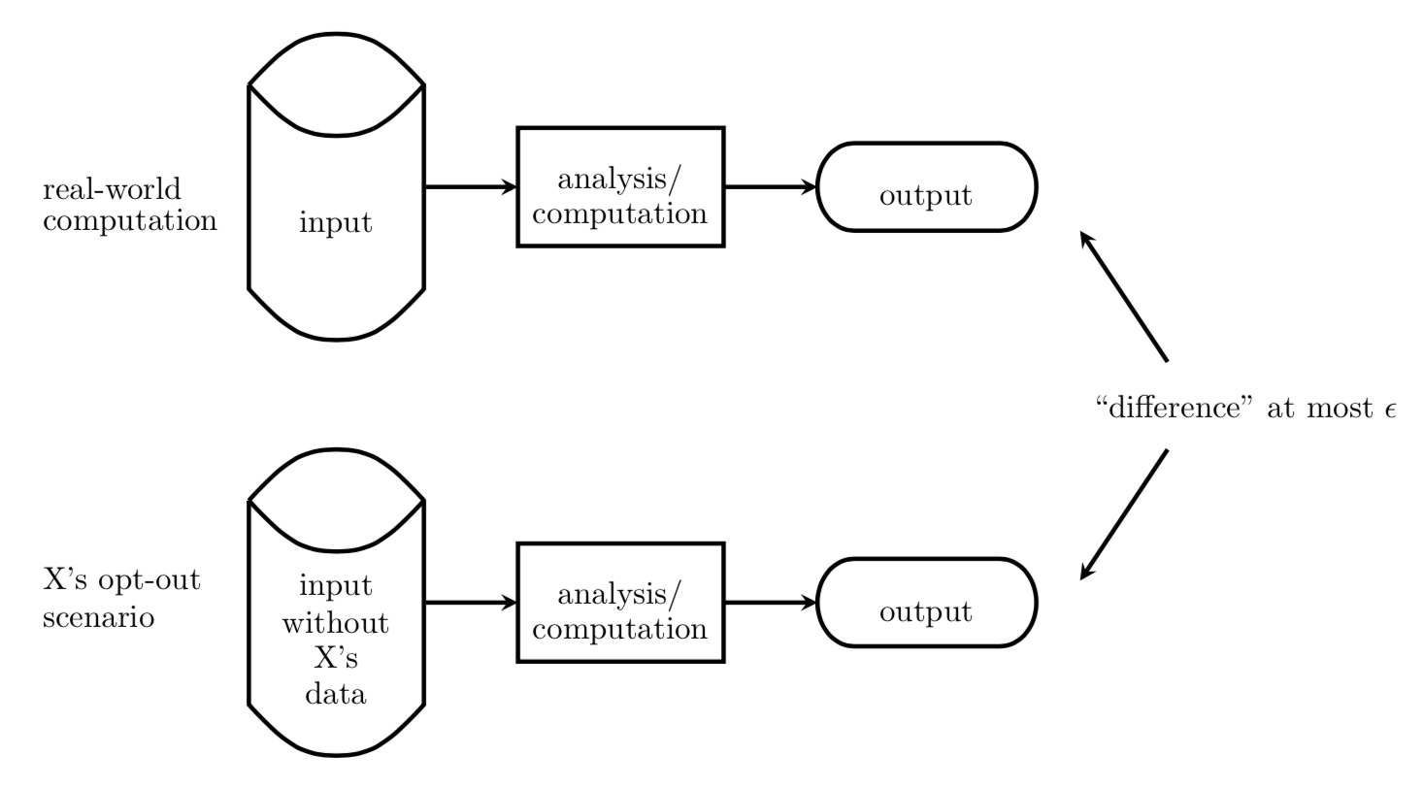
A ”tuning knob” (privacy-utility tradeoff)
The privacy loss parameter, $ε$
Quantifies the amount of deviation between the opt-out and real-world scenarios
NOTE: $ε$ and $ε$ are both valid ways to write epsilon.
***Note the generality. Must hold for everyone in the database.

Slide 16
Understanding $ε$
Smaller $ε$ means a smaller deviation between the real-world analysis and the opt-out scenario (better privacy)
$ε=0$ when the real-world differentially private analysis mimics the opt-out scenario of all individuals perfectly (trivial solution)
***As a rule of thumb, $ε$ should be thought of as a small number, between approximately 0.001 and 1.

Slide 17
The heart of DP
The key to preserving privacy is the informational relationship between the private input and the public output—and not the output itself.
➔ Not only is it necessary to examine the analysis itself to determine whether a statistic can be published while preserving privacy, but it is also sufficient.
In other words, if one knows whether the process used to generate a statistic preserves privacy, the output statistic does not need to be considered at all.

Slide 18
Caveats
Depending on the dataset and the queries it may not be possible to provide responses with good utility/privacy tradeoffs… Relatedly, how to “interpret” the guarantee? What epsilon is sufficient?
Complexity
Presumes a static dataset.
Whoever does the calculation has the data

Slide 19
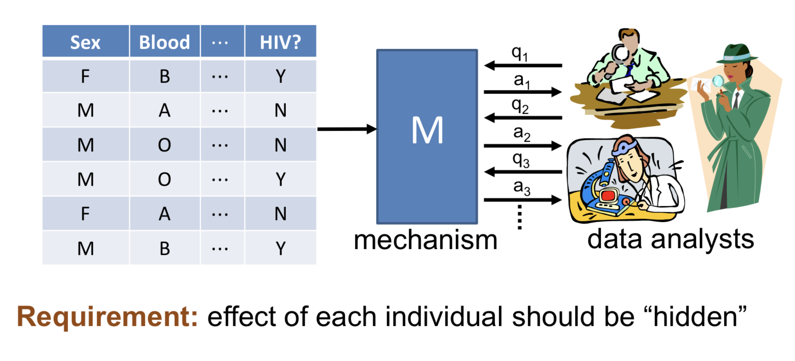
In practice
Honaker and Vadhan, 2019

Slide 20
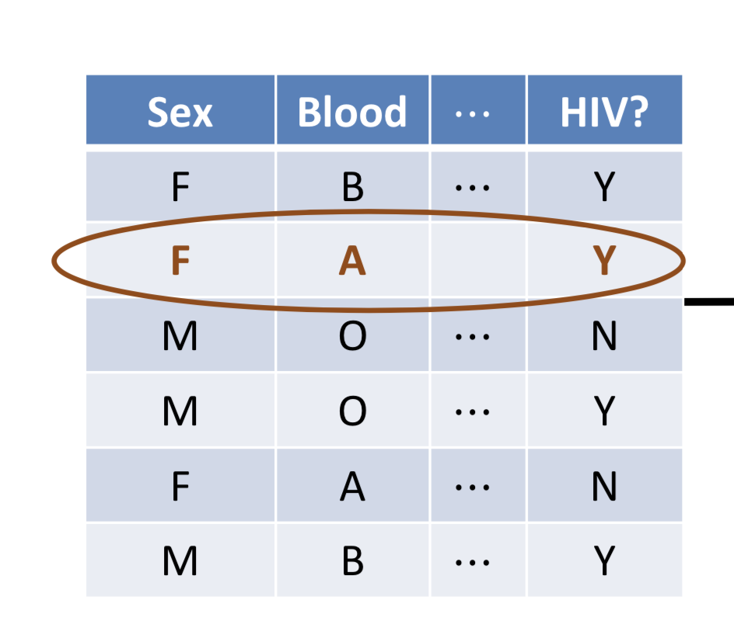
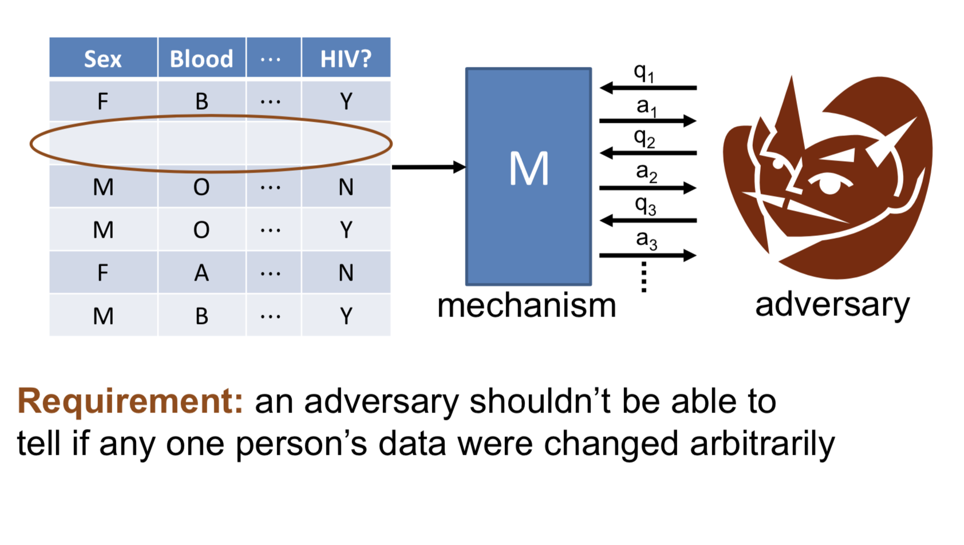
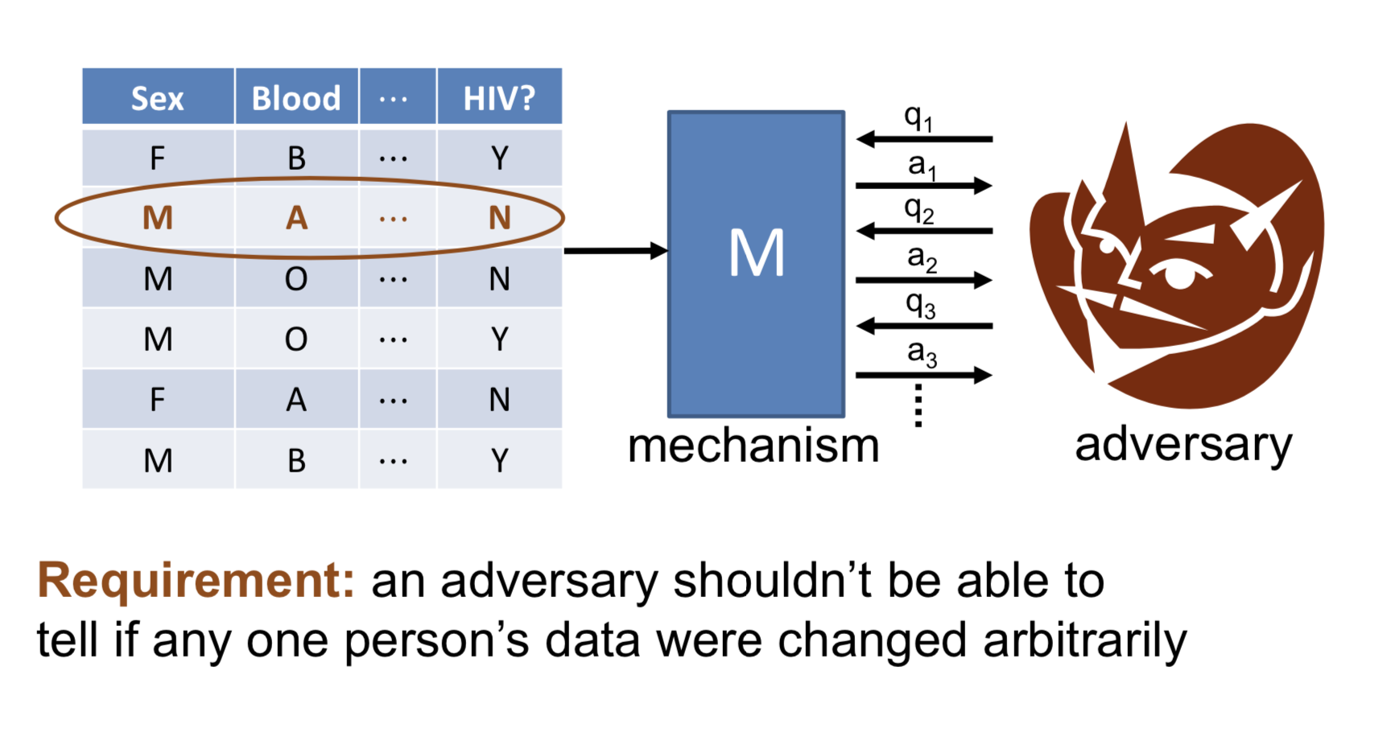
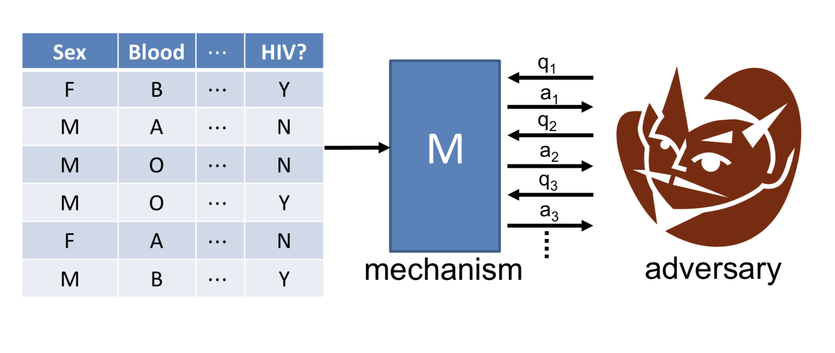
In practice
Honaker and Vadhan, 2019

Slide 21
The mechanism is a probability distribution over outputs, such that if an individual input x_{i} was changed to x_{i}’ the relative probabilities of any output would not change much
Can view as model of “plausible deniability”:
“my input was x_{i}’ and not x_{i}”!!

Slide 22
A definition

Slide 23
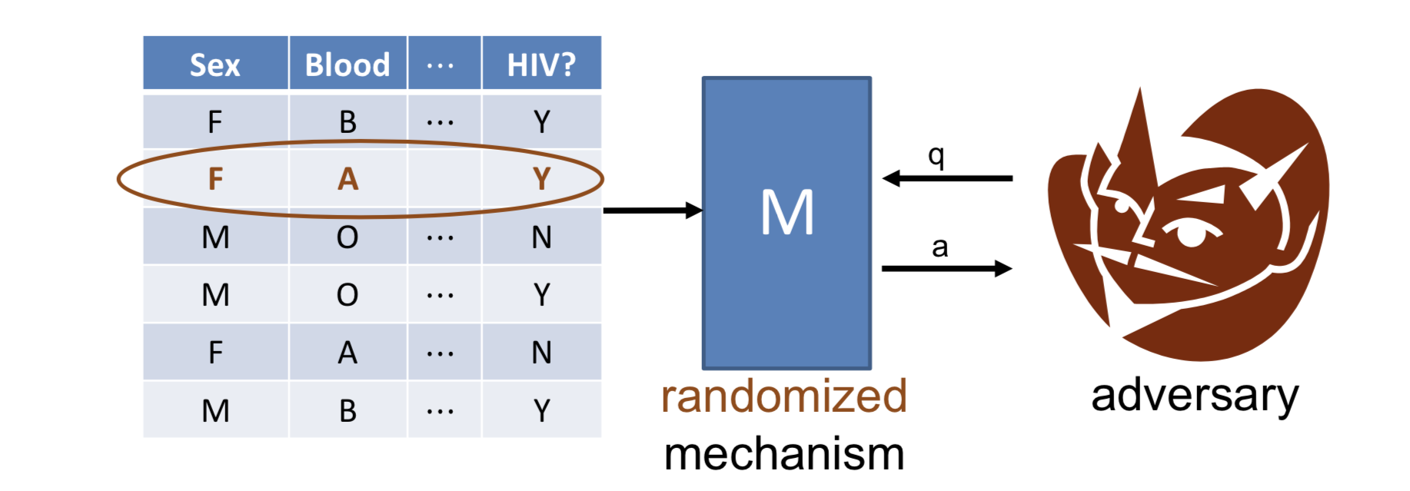
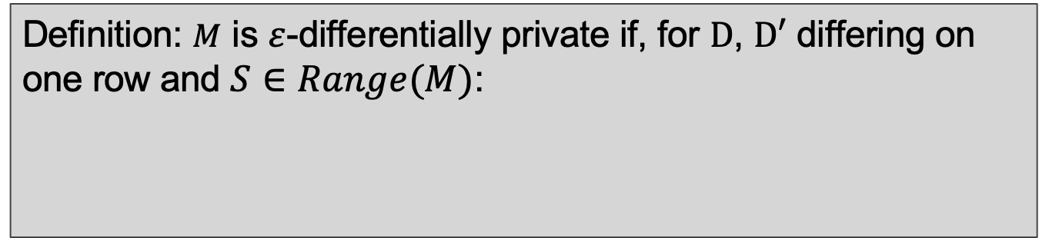
some outcome
space of possible outcomes
Definition: $M$ is $ε$-differentially private if, for $D$, $D′$ differing on one row and $S∈Range(M)$:
$$\operatorname{Pr}\left[M\left(D\right)∈S\right]≤e^{ε}∙Pr⁡[M\left(D′\right)∈S]$$
$≈1+ε$, for very small $ε$

Slide 24
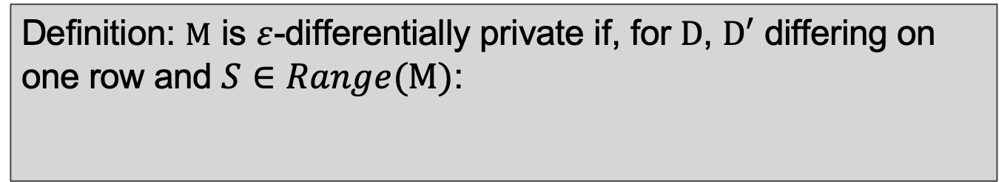
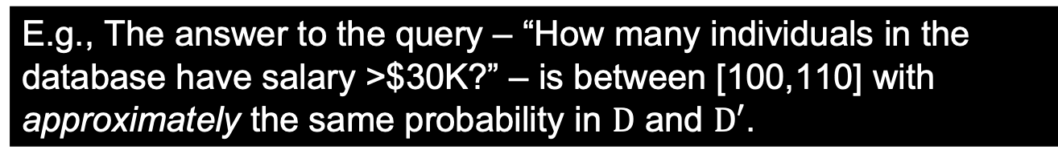
Definition: $M$ is $ε$-differentially private if, for $D$, $D′$ differing on one row and $S∈Range(M)$:
$$\operatorname{Pr}\left[M\left(D\right)∈S\right]≤e^{ε}∙Pr⁡[M\left(D′\right)∈S]$$
E.g., The answer to the query – “How many individuals in the database have salary >$30K?” – is between [100,110] with approximately the same probability in $D$ and $D′$.

Slide 25
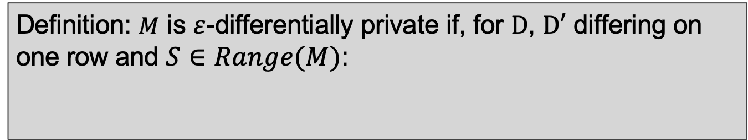
Definition: $M$ is $ε$-differentially private if, for $D$, $D′$ differing on one row and $S∈Range(M)$:
$$\operatorname{Pr}\left[M\left(D\right)∈S\right]≤e^{ε}∙Pr⁡[M\left(D′\right)∈S]$$
$$\frac{\operatorname{Pr}\left[M\left(D\right)∈S\right]}{Pr⁡[M\left(D′\right)∈S]}≤e^{ε}$$
The closer R is to 1, or ε to 0, the more difficult it will be for an attacker to determine an individual’s data.
$$R$$
Adversary knows arbitrary auxiliary information
No linkage attacks
Oblivious to data distribution
Notes:
ε is a publicly known characteristic of our database. It defines the level of privacy maintained and it informs users of the amount of error to expect in the responses it yields.

Slide 26
How do we achieve it?
General idea: “return query result, plus some noise”

Slide 27
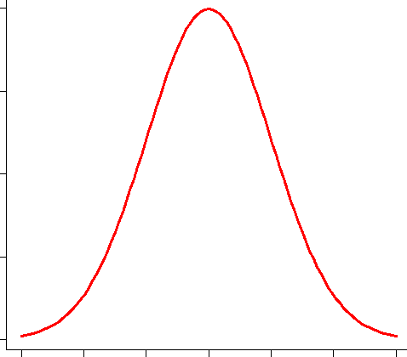
How to achieve it
You could, for example, perturb the output by adding Gaussian noise to the result of the query
Notes:
Laplacian is the most used kind of noise

Slide 28
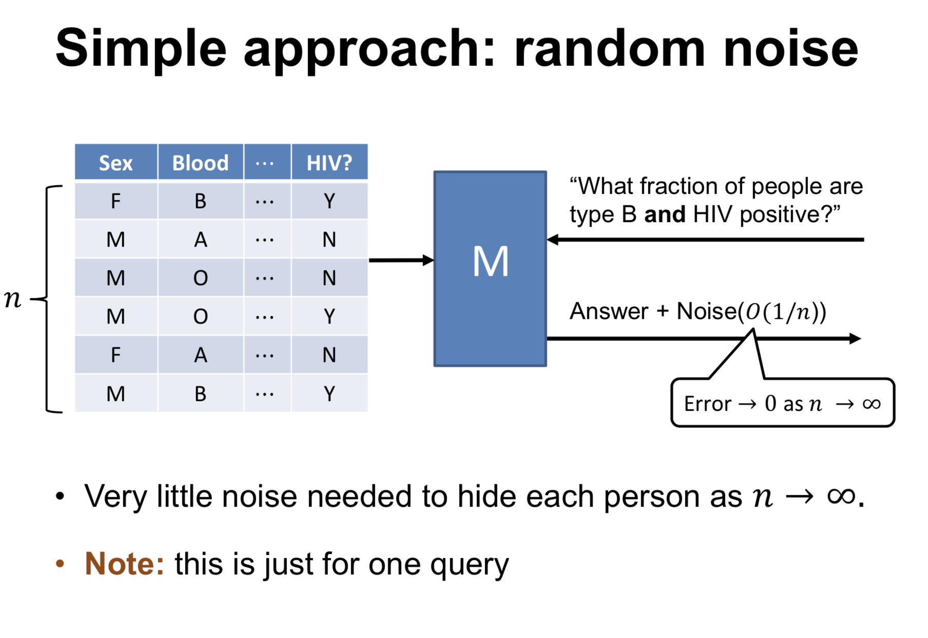
Honaker and Vadhan, 2019

Slide 29
η
The Laplace Mechanism

Slide 30
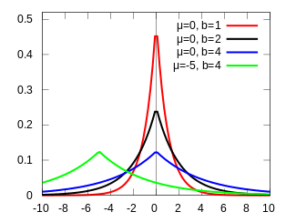
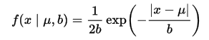
The Laplace Distribution
A random variable has a Laplace distribution if its PDF is:
location
scale
Denoted $Lap(μ,b)$
Denoted $Lap(b)$ when $μ=0$
Mean $μ$
Variance $2b2$
Wikipedia, Creative Commons license
Notes:
If mu is 0 and b is 1, the positive half-life is exactly an exponential distribution scaled by ½.

Slide 31
The guarantee

Slide 32
Theorem: For $f:D→ℝ^{d}$ , the mechanism $M$ that adds independently generated noise with distribution $Lap\left(\frac{{GS}_{f}}{ε}\right)$ to each of the $d$output terms is $ε$-differentially private.
Scale = sensitivity/epsilon
**more on sensitivity after the break
That means: when M is a function that adds noise to a query, and that noise that gets added is drawn from the Laplace distribution parametrized appropriately, we can guarantee the output of the query satisfies the formal definition of epsilon-privacy.

Slide 33
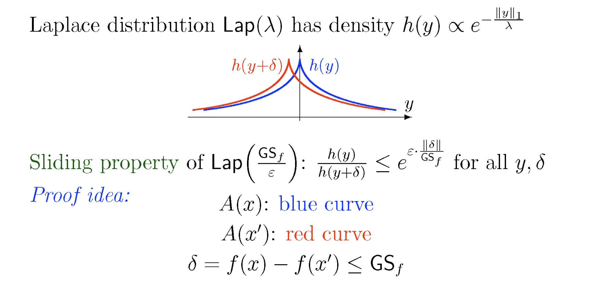
Theorem: For $f:D→ℝ^{d}$ , the mechanism $M$ that adds independently generated noise with distribution $Lap\left(\frac{{GS}_{f}}{ε}\right)$ to each of the $d$output terms is $ε$-differentially private.
$$M\left(x\right):$$
$$M\left(x′\right):$$

Slide 34
DP code example: The model
Head to https://mybinder.org
From there, launch https://github.com/SarahRajtmajer/DataPrivacy_Spring2022
Open “Introduction to DP.ipynb”

Slide 35
Break (& post to discussion)

Slide 36
Presentation

Slide 37
Sensitivity of a Query

Slide 38
Theorem: For $f:D→ℝ^{d}$ , the mechanism $M$ that adds independently generated noise with distribution $Lap\left(\frac{{GS}_{f}}{ε}\right)$ to each of the $d$output terms is $ε$-differentially private.
Scale = sensitivity/epsilon
**more on sensitivity after the break
That means: when M is a function that adds noise to a query, and that noise that gets added is drawn from the Laplace distribution parametrized appropriately, we can guarantee the output of the query satisfies the formal definition of epsilon-privacy.

Slide 39
The Laplace Distribution
A random variable has a Laplace distribution if its PDF is:
location
scale
Denoted $Lap(μ,b)$
Denoted $Lap(b)$ when $μ=0$
Mean $μ$
Variance $2b2$
Wikipedia, Creative Commons license
Notes:
If mu is 0 and b is 1, the positive half-life is exactly an exponential distribution scaled by ½.

Slide 40
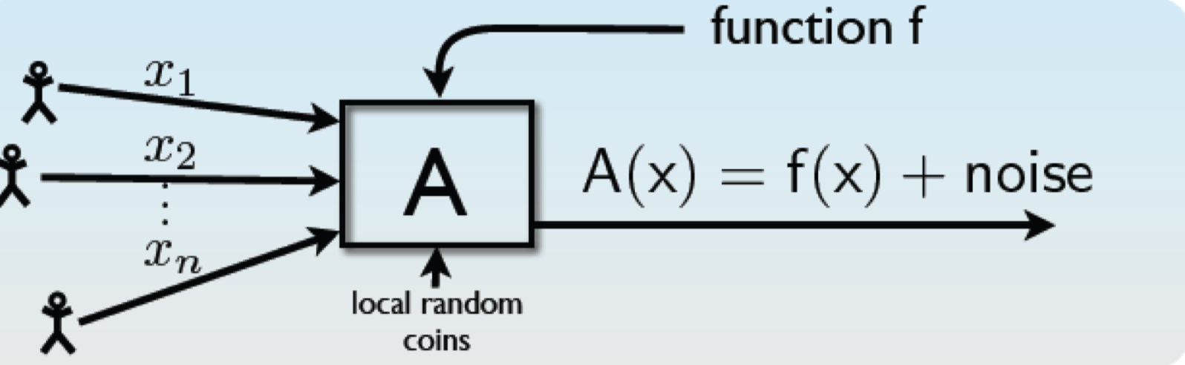
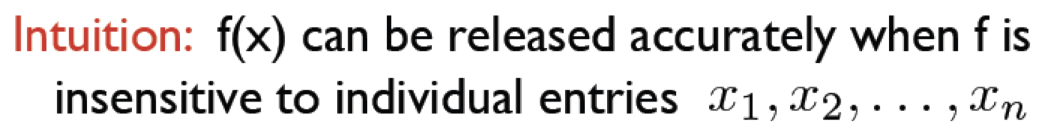
Ex. Consider a user asking for the answer $f\left(x\right)$. How much noise needs to be added in the output?

Slide 41
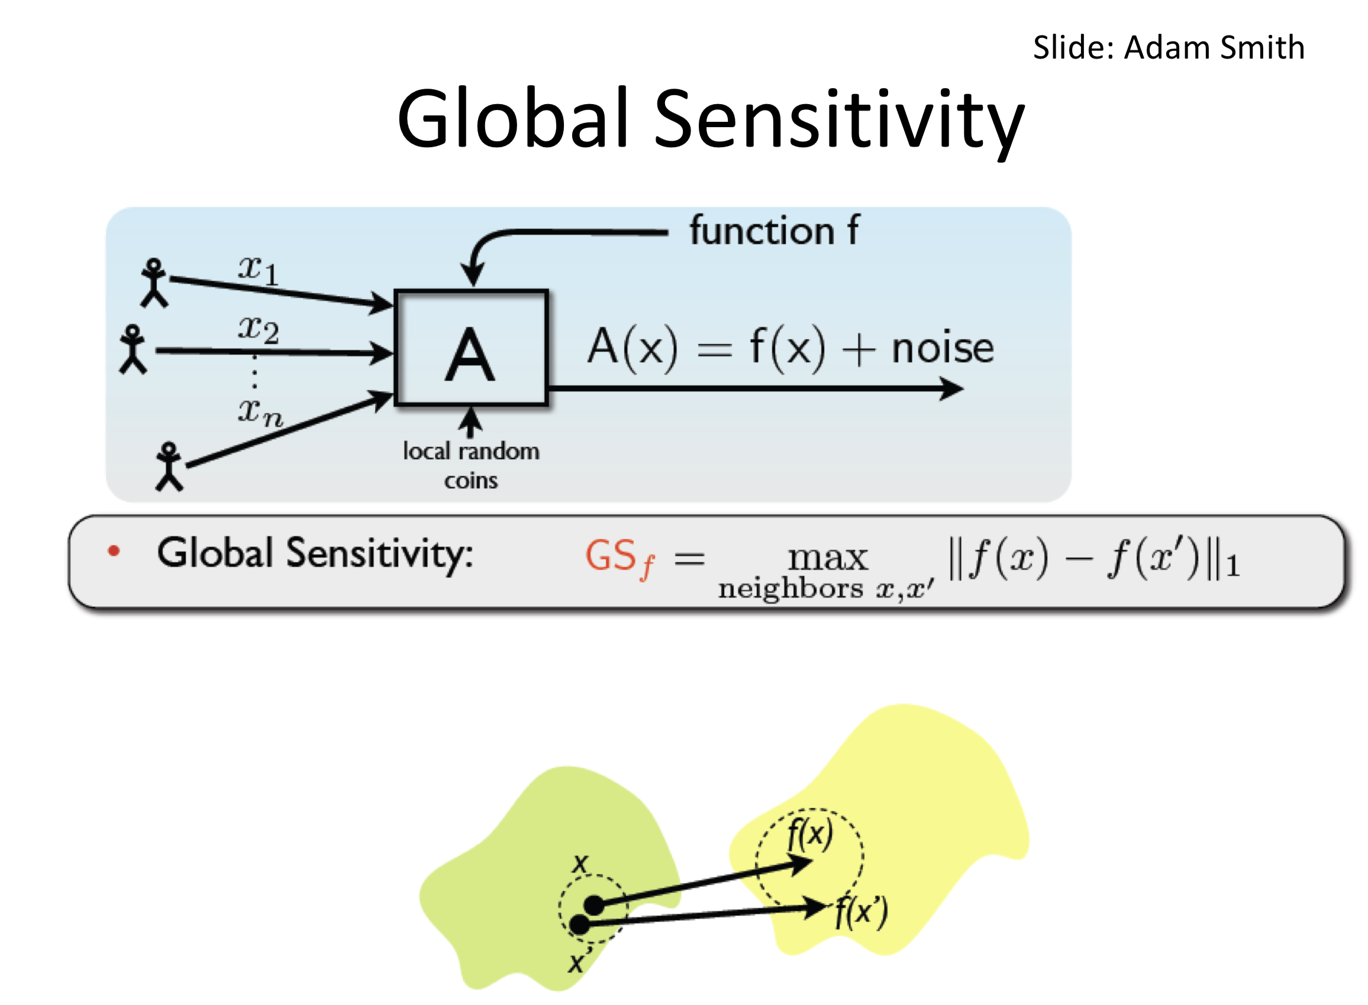
Database with Alice’s record
Database without Alice’s record
Slide: Adam Smith

Slide 42
Let’s return to our earlier query.
“How many individuals in the database have salary >$30K?”
What is the global sensitivity of this query?
$${GS}_{f}=\max_{neighbors D,D′}\left\|f\left(D\right)−f(D^{′})\right\|$$
Database with Alice’s record (D)
Note: Adding or removing a row can only change the answer by 1.
--> Global sensitivity for simple counting queries is 1.
Database without Alice’s record (D’)

Slide 43
Now consider a slightly different query.
“What is the combined total salary of all females in the database?”
What is the global sensitivity of this query?
$${GS}_{f}=\max_{neighbors D,D′}\left\|f\left(D\right)−f(D^{′})\right\|$$
Set of females’ salaries in the database
$$f\left(x\right)=\sum_{i=1}^{n}{x_{i}}$$
Database with Alice’s record (D)
for $x_{i}∈S$
$max(x_{i})$
Database without Alice’s record (D’)

Slide 44
Try this one on your own.
“What is the average salary of all females in the database?”
What is the global sensitivity of this query?
$${GS}_{f}=\max_{neighbors D,D′}\left\|f\left(D\right)−f(D^{′})\right\|$$
$$f\left(x\right)=\frac{1}{n}\sum_{i=1}^{n}{x_{i}}$$
for $x_{i}∈S$
$$\frac{max(x_{i})}{n}$$

Slide 45
DP code example: Sensitivity
Head to https://mybinder.org
From there, launch https://github.com/SarahRajtmajer/DataPrivacy_Spring2022
Open “Sensitivity.ipynb”

Slide 46
Reminder: Class on March 14 will be on Zoom
fun spring break reading!! Wood’s “Nontechnical primer…”
Reminder: Extra credit! 1 point on any HW (of 15) – due March 21
(Try a new tool! Answer all questions, including Bonus!)
https://teachingprivacy.org/wp-content/uploads/2015/06/TROPE_Protect_Your_Anonymity_Maybe.pdf
Thank you!

